Slide 1
The True Size of Africa

Slide 2
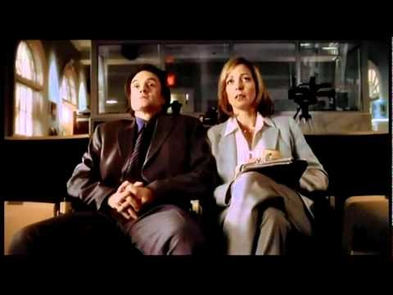
Why is this so shocking to these people?

Slide 3
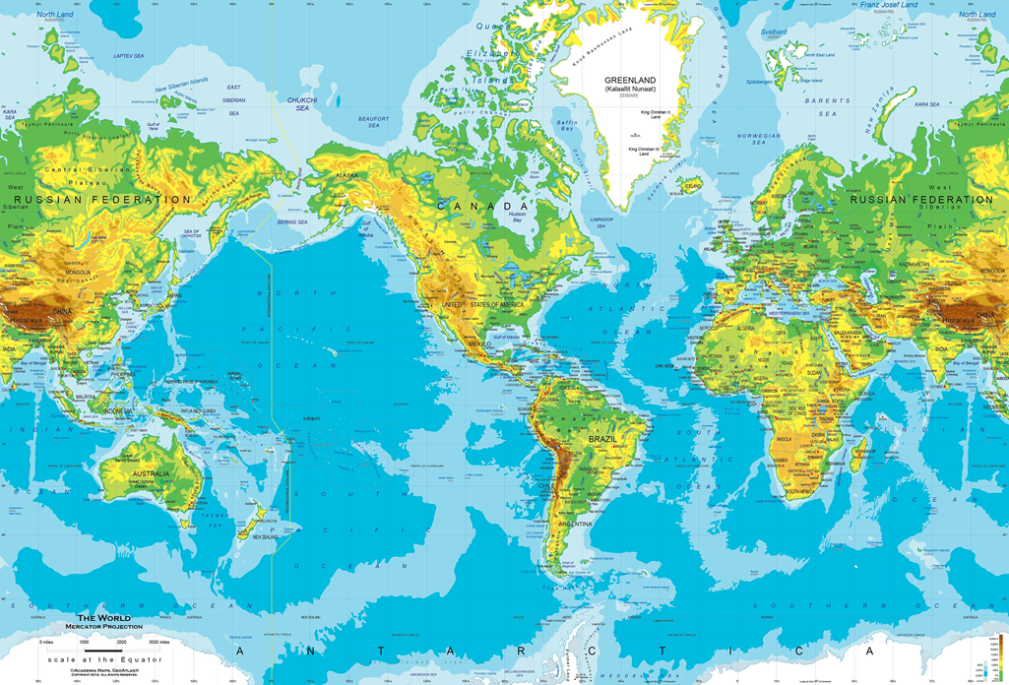
The Mercator Projection

Slide 4
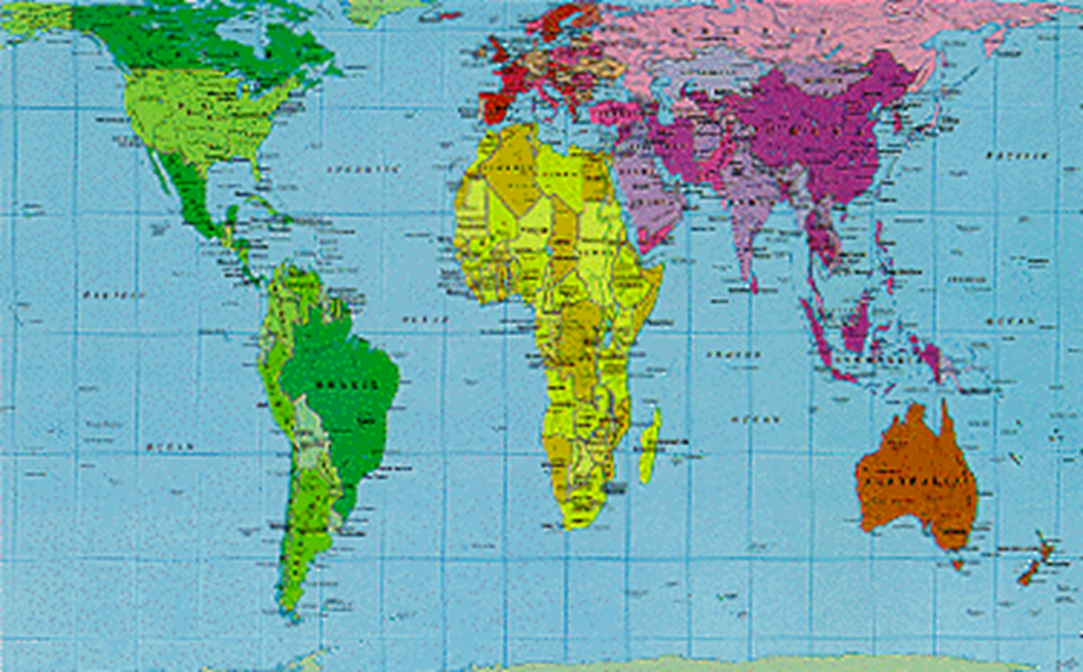
The Peters Projection

Slide 5
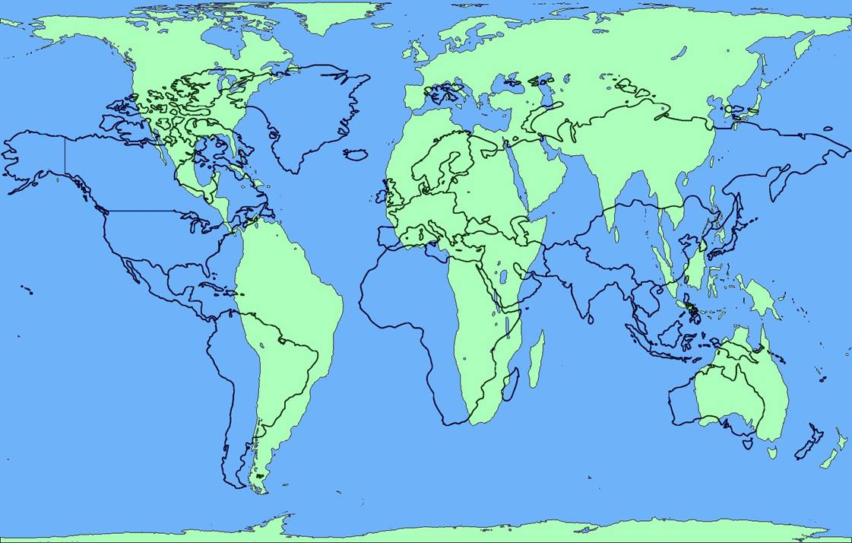
Mercator versus Peters

Slide 6
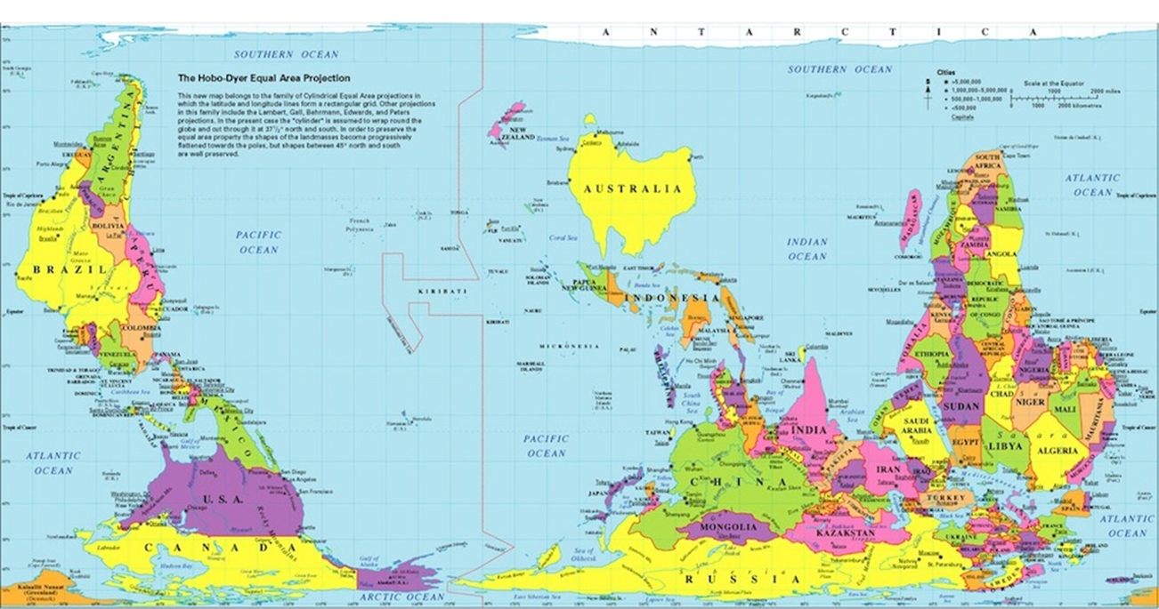
Hobo-Dyer Projection

Slide 7
?????
What areas seem bigger in the Mercator projection?
What areas seem bigger in the Peters projection?
How does the Hobo-Dyer projection change your view of the world?

Slide 8
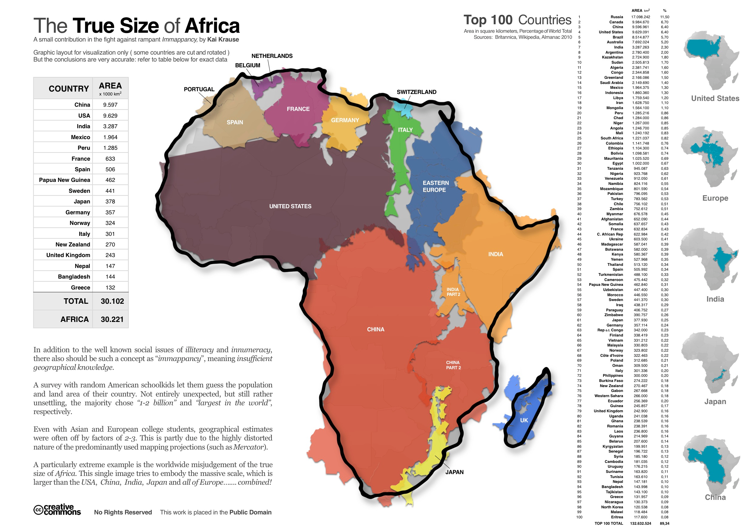

Slide 9
?????
How could learning the true size of Africa change a person’s view of Africa?
How many people do you think live in Africa?

