Slide 1
Writing an Argument

Slide 2
Parts of a Well-Written Argument
Thesis statement
Evidence
Transition words
Debunk
Conclusion

Slide 3
Thesis Statement
A short statement that sums up the argument you are making.
Avoid saying “I think,” “In my opinion,” “If you ask me,” etc. Why do you think we should avoid this?

Slide 4
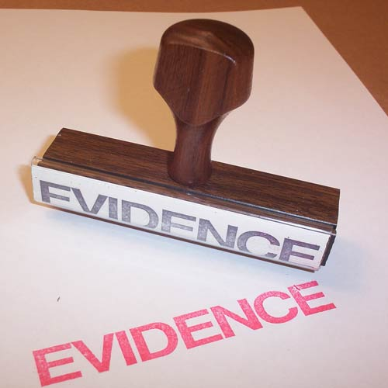
Evidence
Evidence supports your thesis statement.
Strongest first or strongest last.
What makes a good piece of evidence?

Slide 5
Transition Words
Words like:
First
In addition
Therefore
Finally
Etc.
Makes your argument flow better on paper

Slide 6
Debunk
A debunk takes a piece of evidence for the other side, and disproves it.
“Some argue that middle school students should wake up earlier so they learn responsibility. However, most studies show middle school students need more sleep in order to learn anything.”

Slide 7
Conclusion
Restate your thesis statement, only more strongly.
“Without a doubt, middle school should start later in the day if students are to live up to their full potential.”

